Slide 1
Square and Middle Point Detection

Slide 2
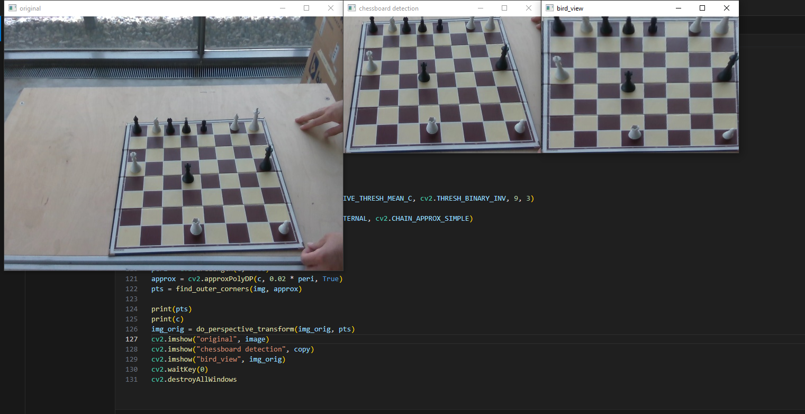
First Step: Chessboard Detection
By using YOLOv8, chessboard detection has been done.

Slide 3
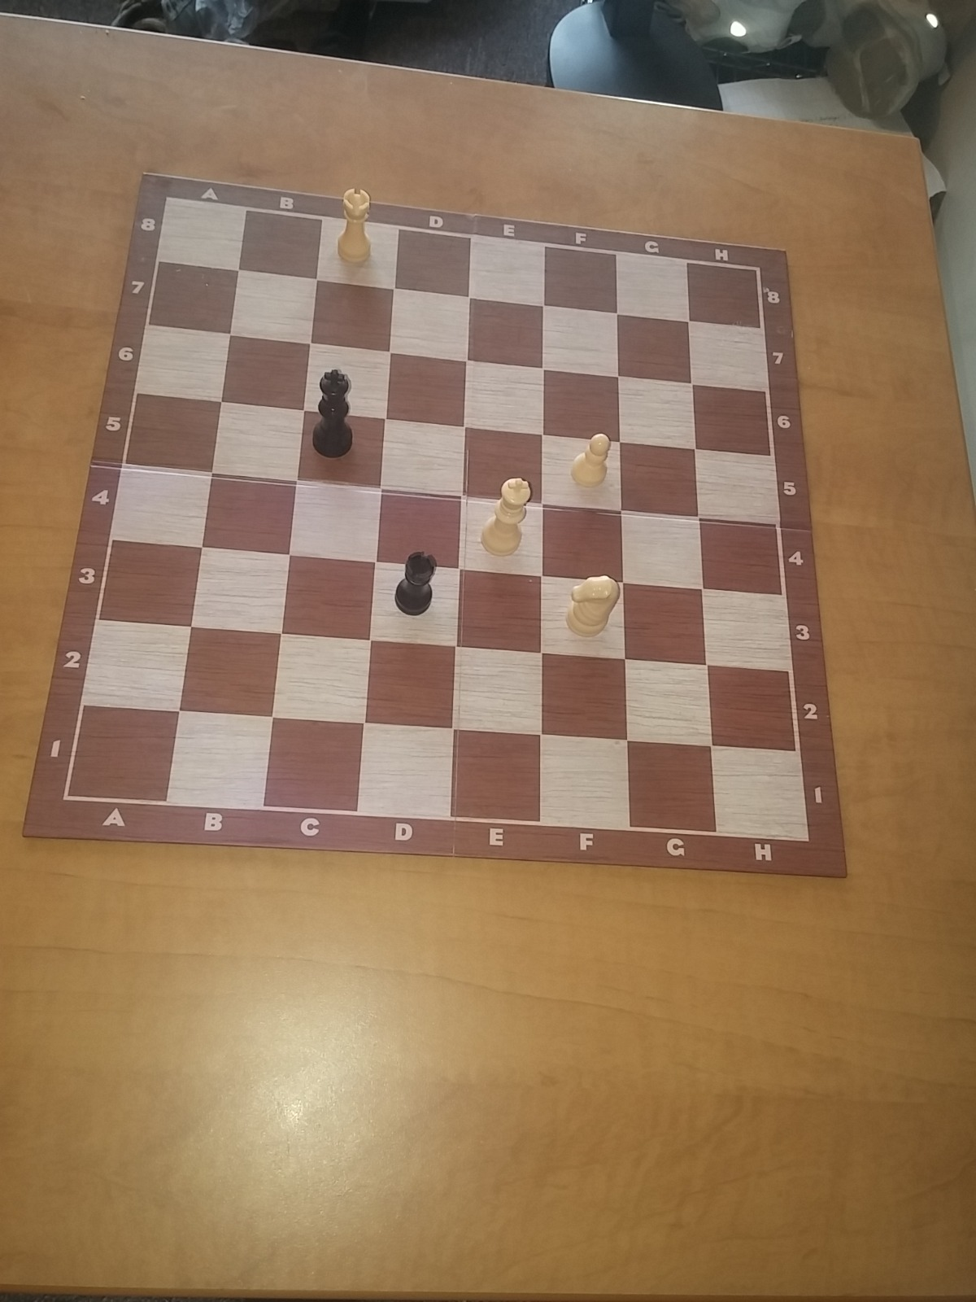
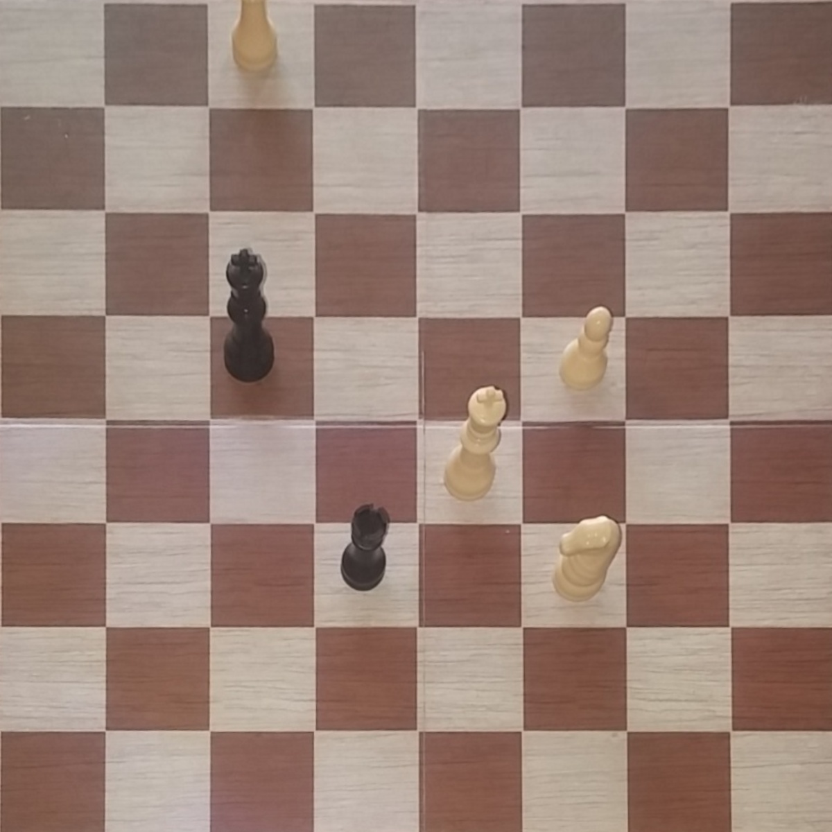
Second Step: Perspective Transform
getPerspectiveTranform
&
warpPerspective

Slide 4
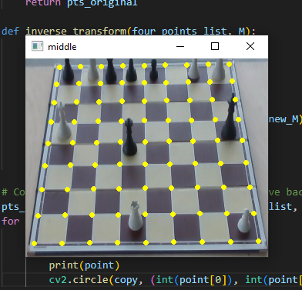
Third Step: Finding Corners
By using basic mathematics, all corners can be found.

Slide 5
Fourth Step: Inverse Perspective Transform
By using inverse matrix of the perspective transform from second step, all squares and corner points can be found in the original image.
Inverse transform has been applied.
Basic mathematical operations have been applied.
From the corner coordinates of the squares in the original image, all middle points’ coordinates can be found.

Slide 6
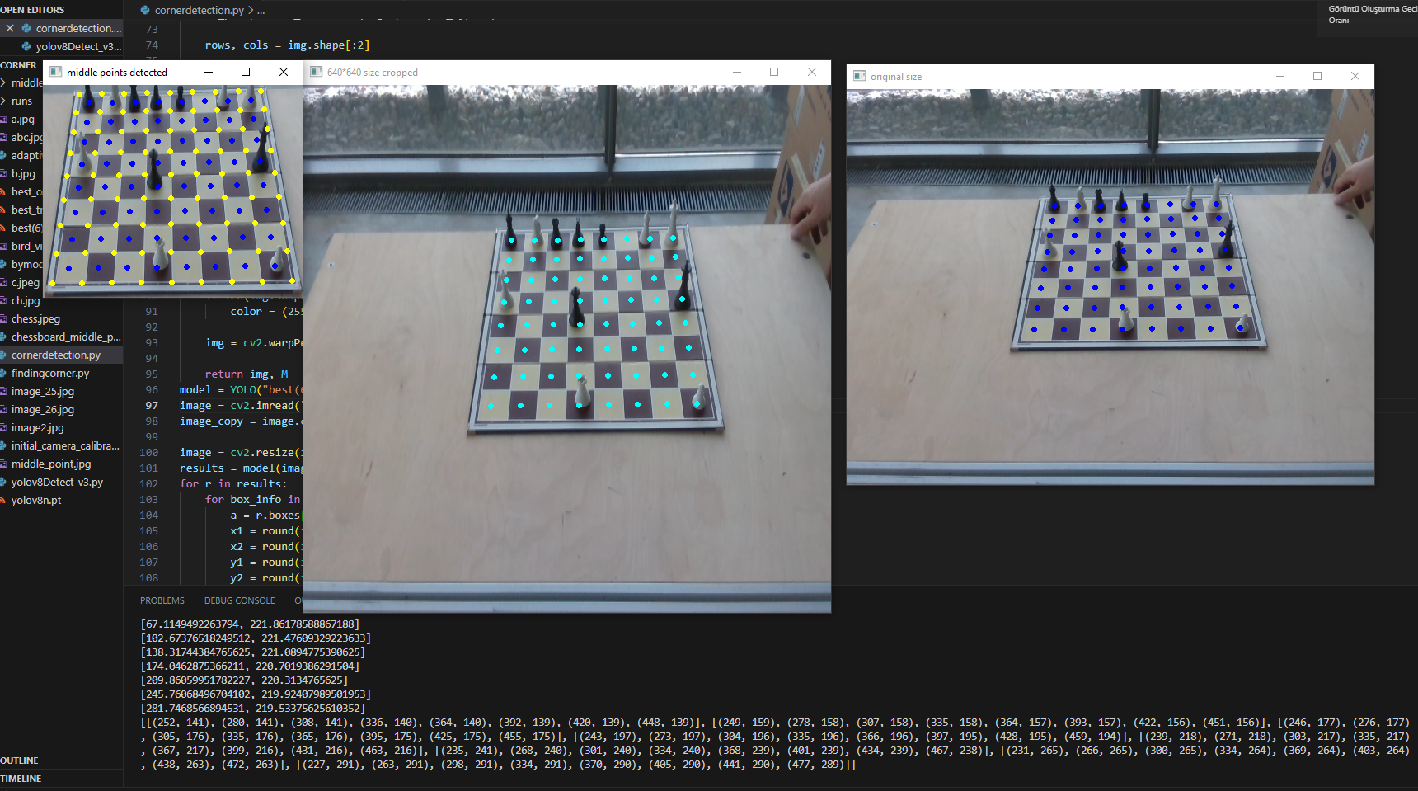

Slide 7
Chess Pieces Detection by YOLOv8

Slide 8
Steps
Dataset Preparation
Collecting Data
Labelling
Image Preprocessing
Augmentations
Training Model
Evaluating Performance of the Model
Testing Model

Slide 9
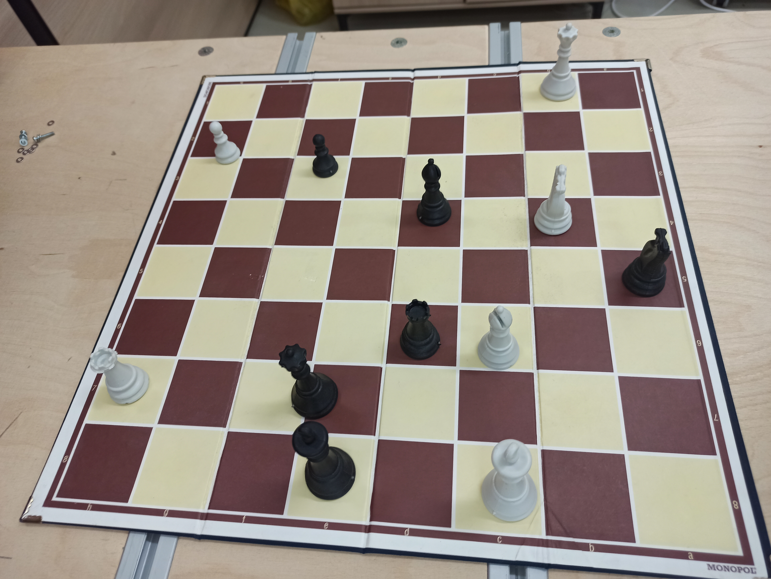
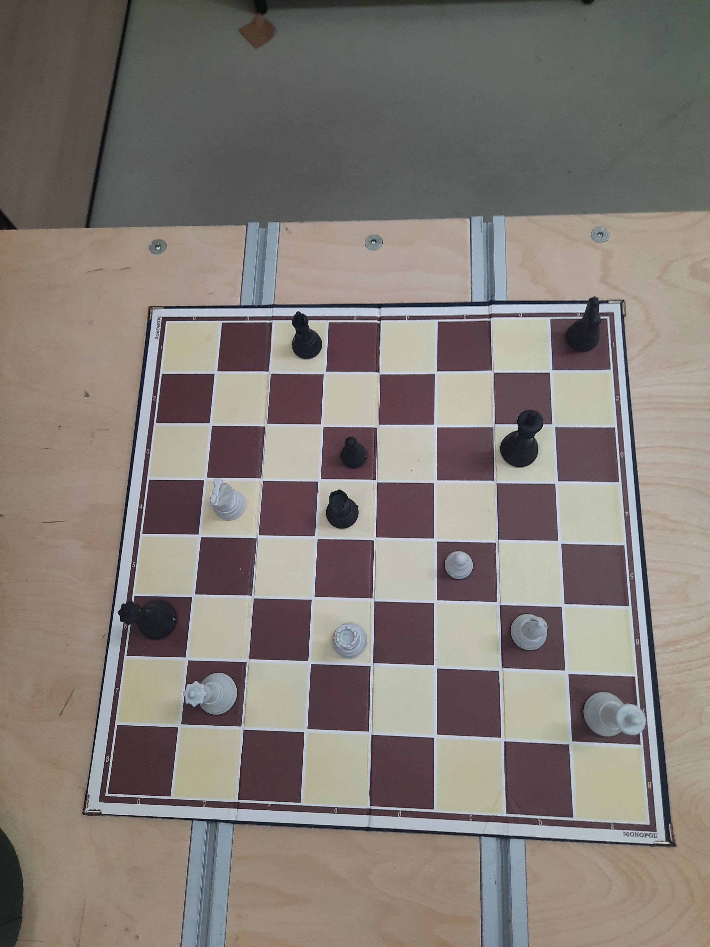
Collecting Data

Slide 10
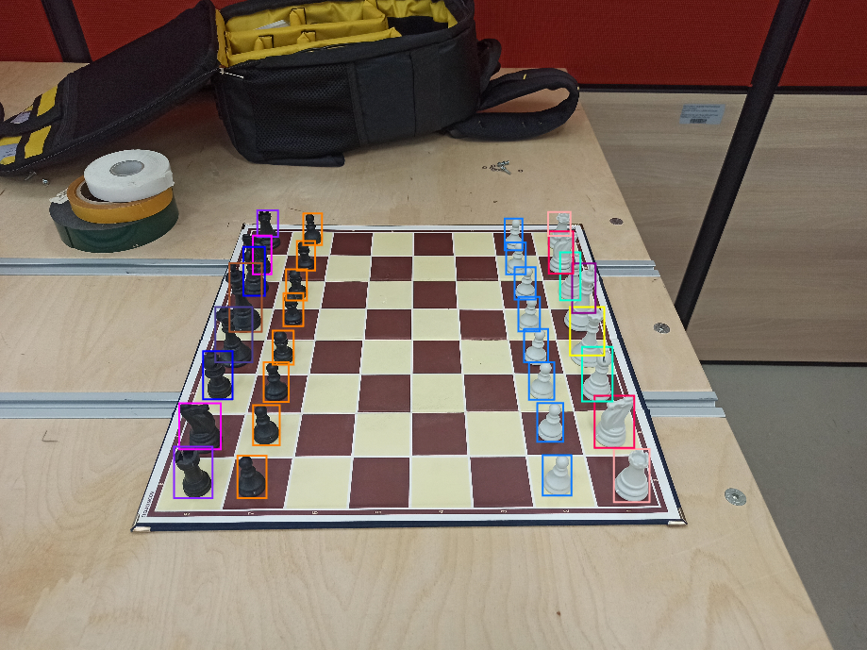
Labelling
Done by using Roboflow
12 classes created:
N
P
B
R
K
Q
n
p
b
r
k
q

Slide 11
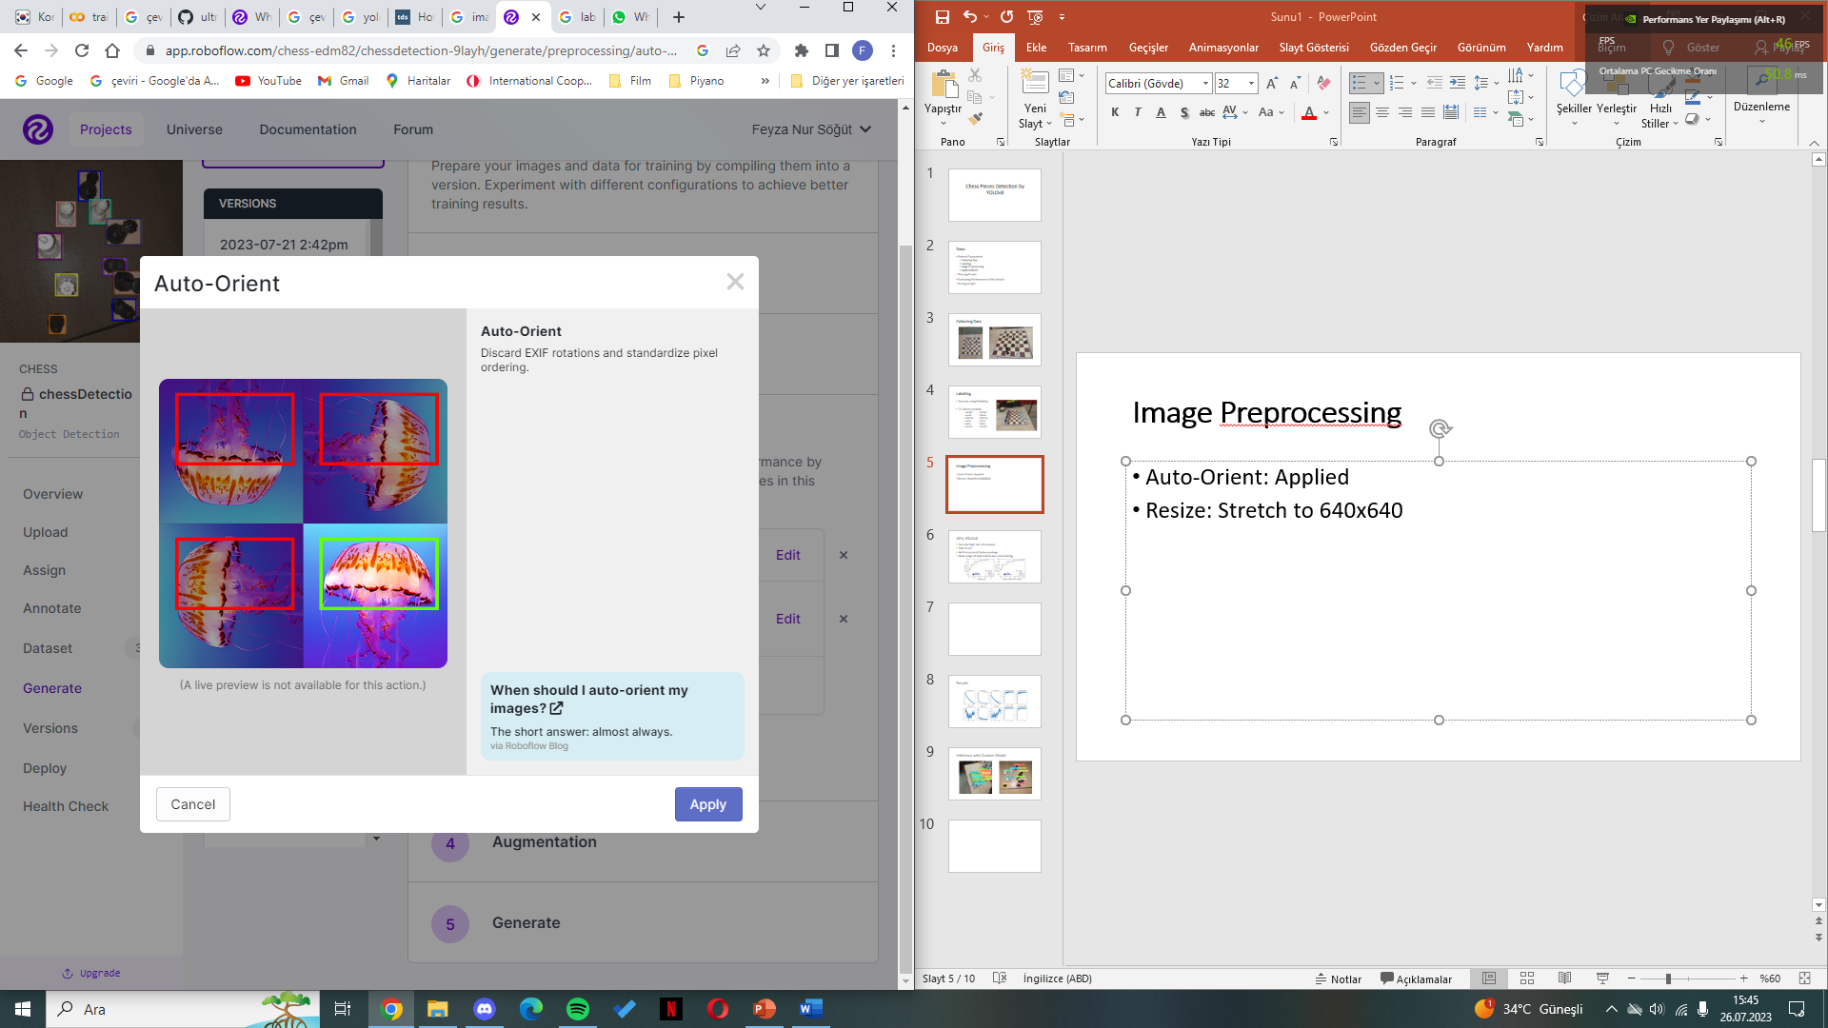
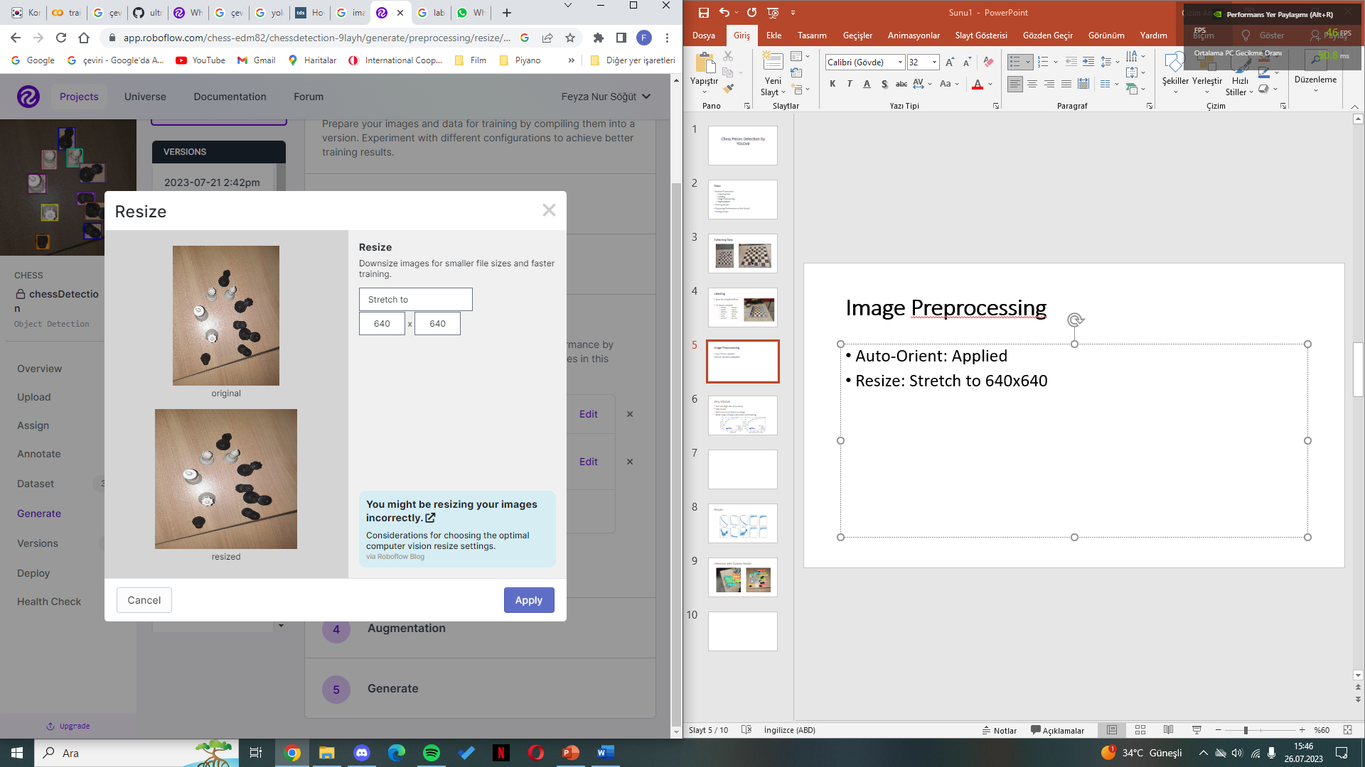
Image Preprocessing
Auto-Orient: Applied Resize: Stretch to 640x640

Slide 12
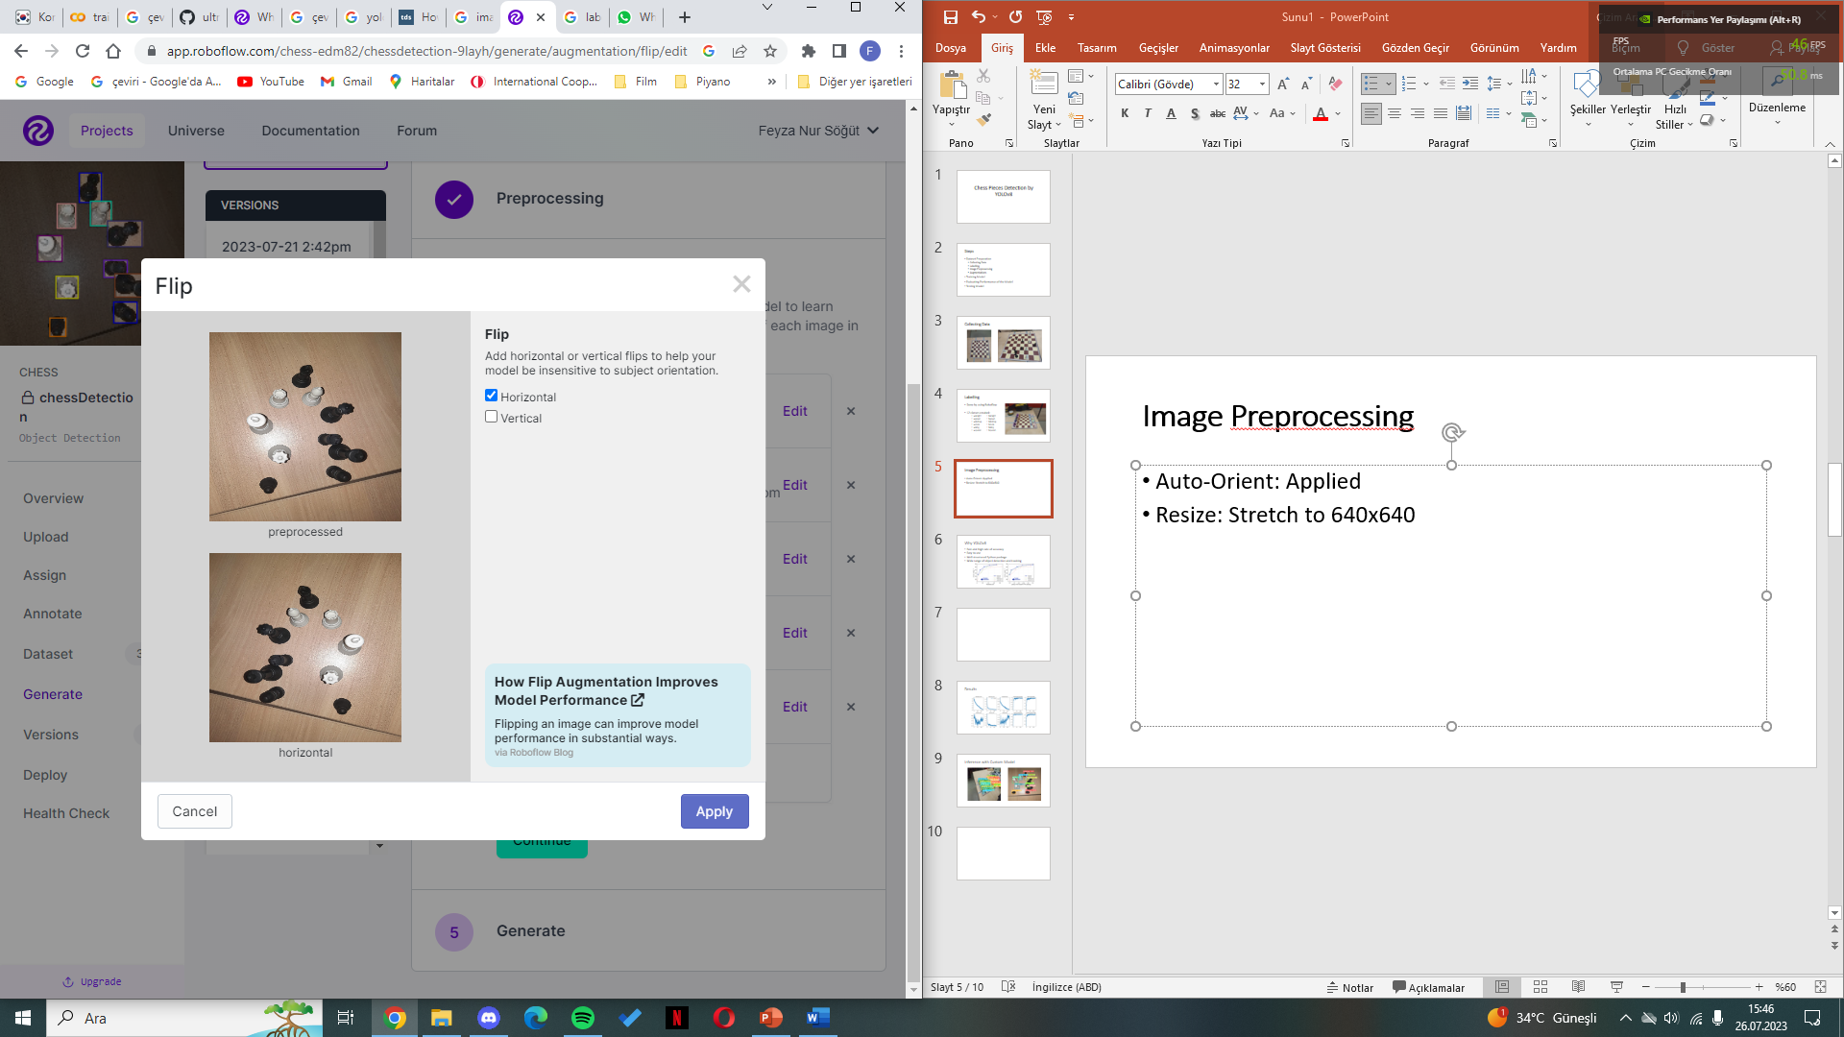
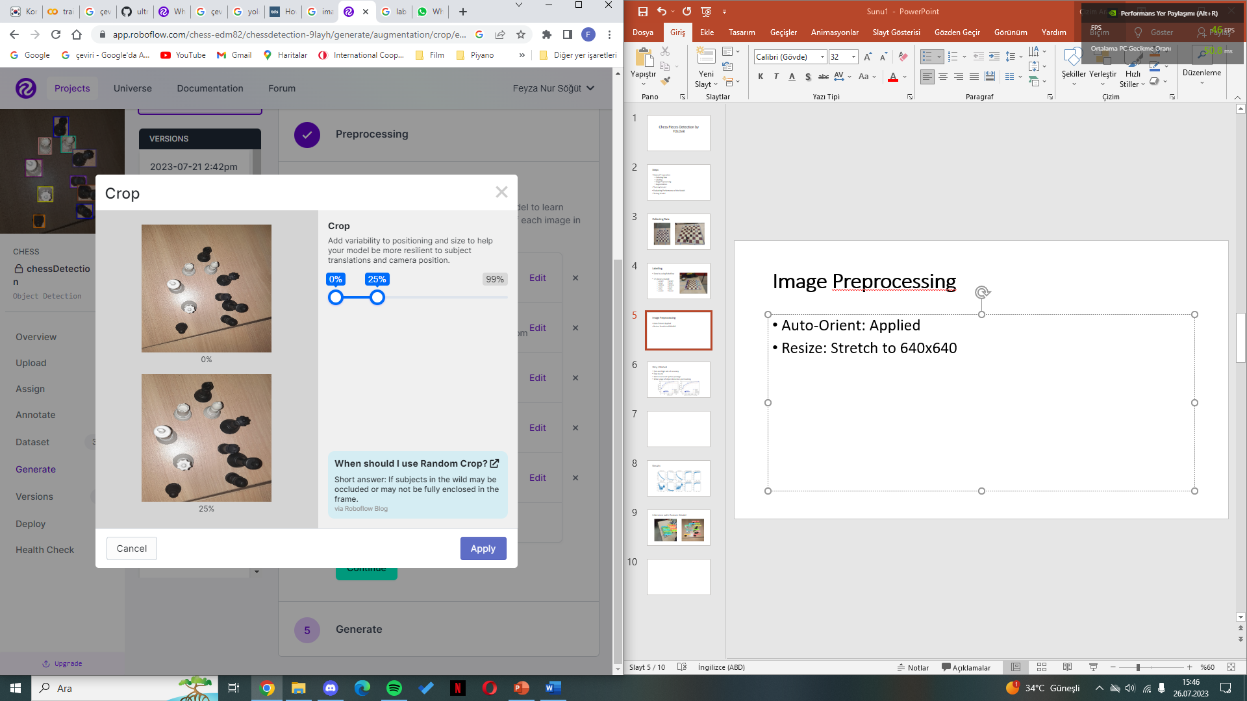
Augmentations
Flip: Horizontal Crop: 0% - 25%

Slide 13
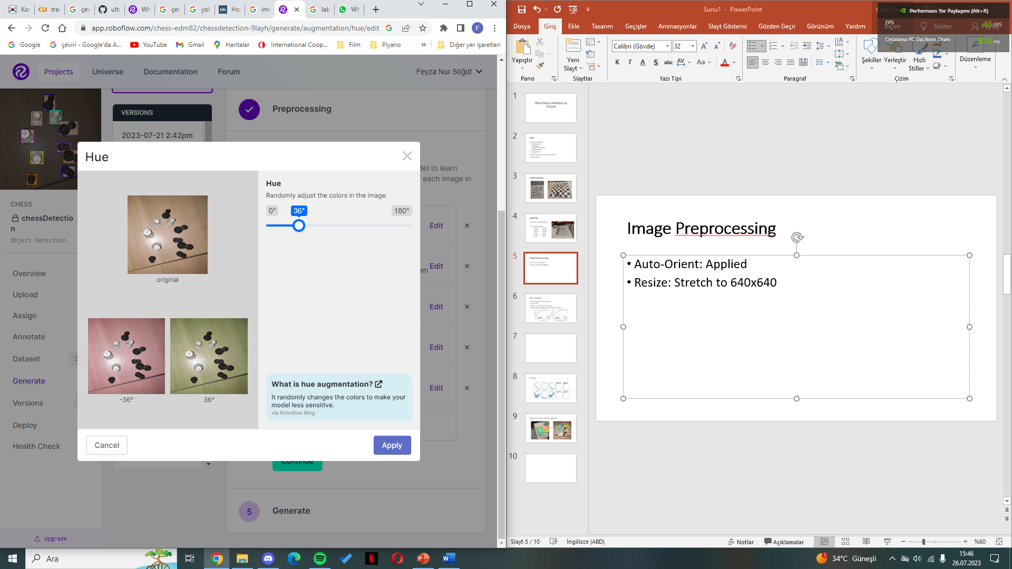

Augmentations
Hue: Between -36° and +36° Brightness: Between -22% and +22%

Slide 14
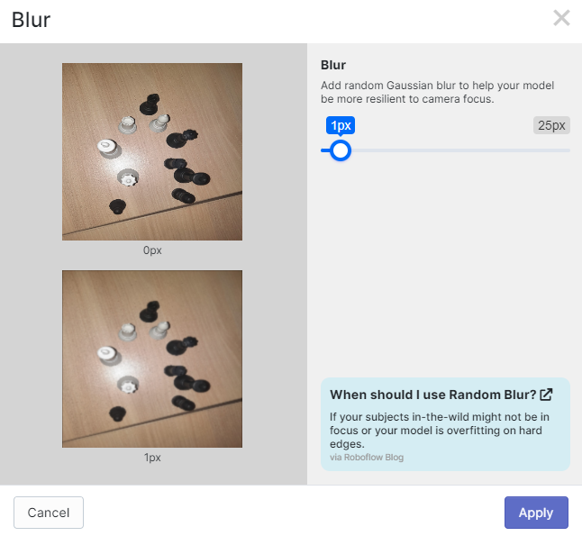
Augmentations
Blur: Up to 1px
1053 images have been collected!

Slide 15

Training Model
YOLOv8 has been used to detect chess pieces.

Slide 16
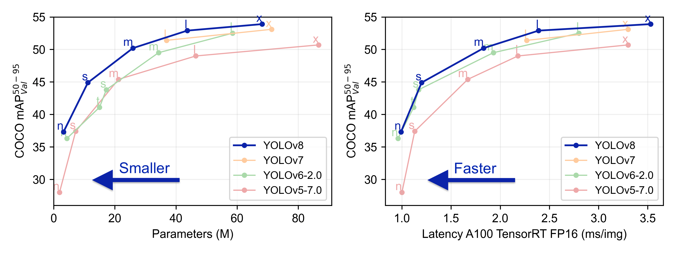
Why YOLOv8
Fast and high rate of accuracy
Easy to use
Well-structured Python package
Wide range of object detection and tracking

Slide 17
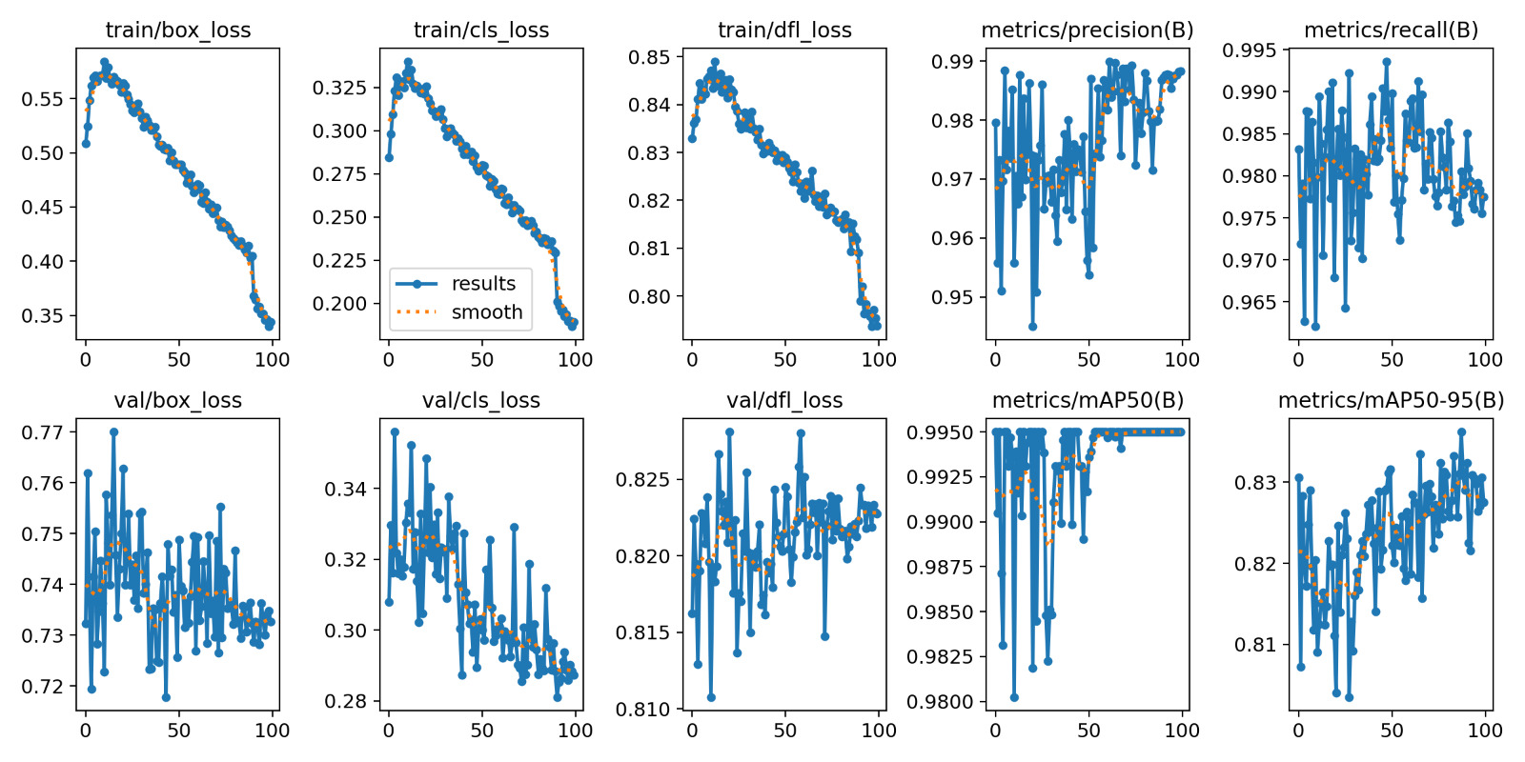
Evaluating Performance of the Model

Slide 18
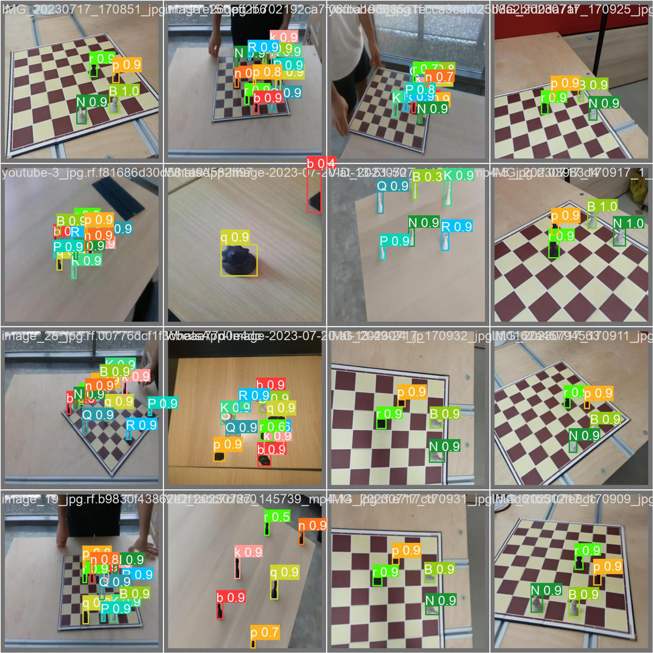
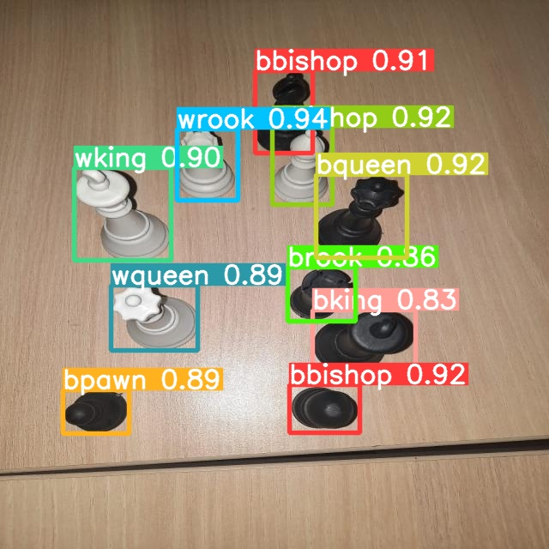
Testing Model

Slide 19
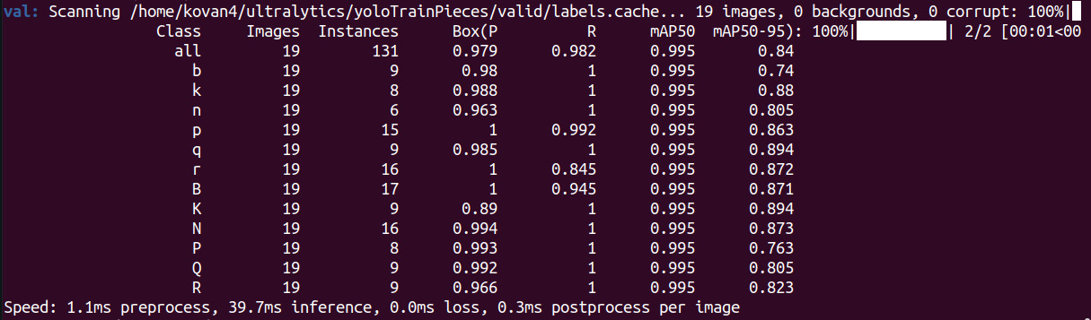
Results
Mean Average Precision from 50 to 95IoU
Mean Average Precision at 50 IoU

